Slide 1
Computer Science
Mr. Eddie

Slide 2
Agenda

Slide 3

Agenda
Introductions
Do Now
Search Engines & Directories
Activity - Job Search
Discussion
Activity - Searching
Discussion - What is Netiquette?
Exit Ticket

Slide 4
About Me

Slide 5






Mr. Eddie
Computer Science Teacher
Full-Stack Web Developer

Slide 6
Do Now
Answer the following questions:
Have you ever gone to a store or a restaurant and the worker was rude to you?
Have you ever thought to yourself that if you were the boss at that place, you would fire that person?
What was it about that worker that made you think they were bad at their job or a bad employee? Was there something different they could have done, another way they could have behaved, or something they could have said that would have changed your mind about them?

Slide 7
Unit 1
Using Online Search Tools to Locate & Evaluate Information Pt. 1

Slide 8

Objectives
understand the difference between a search engine and a search directory.
understand the various search techniques such as keyword, Boolean, and phrases.
explain the importance of computer ethics and proper netiquette, both in the workplace and socially.

Slide 9

Agenda
Introductions
Do Now
Search Engines & Directories
Activity - Job Search
Discussion
Activity - Searching
Discussion - What is Netiquette?
Exit Ticket
Notes:
Cmd+shift+x for strikethrough

Slide 10


Directory or Search Engine?
Search Engine: A web search engine or Internet search engine is a software system that is designed to carry out web search, which means to search the World Wide Web in a systematic way for particular information specified in a textual web search query.
Directory: In computing, a directory is a file system cataloging structure which contains references to other computer files, and possibly other directories. On many computers, directories are known as folders, or drawers, analogous to a workbench or the traditional office filing cabinet.

Slide 11

Examples of Search Engines

Slide 12

Examples of Directories

Slide 13
Agenda
Introductions
Do Now
Search Engines & Directories
Activity - Job Search
Discussion
Activity - Searching
Discussion - What is Netiquette?
Exit Ticket
Notes:
Cmd+shift+x for strikethrough

Slide 14
Activity #1
Job Search

Slide 15

Activity #1
Search for ten I.T. (Information Technology) and|or web development roles in NYC (Write down the websites and|or companies you used to refer back to these posts)
Up to 10 postings.
Minimum of 8
Sign On to your MacBooks

Slide 16
Agenda
Introductions
Do Now
Search Engines & Directories
Activity - Job Search
Discussion
Activity - Searching
Discussion - What is Netiquette?
Exit Ticket
Notes:
Cmd+shift+x for strikethrough

Slide 17
Activity #2
Searching for information

Slide 18
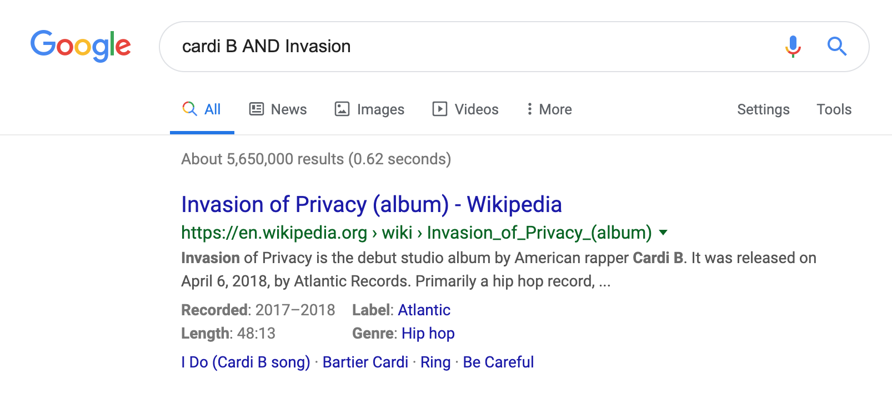
Searching for Information
Booleans, Keywords, Phrases
Boolean Search: a type of search allowing users to combine keywords with operators (or modifiers) such as AND, NOT and OR to further produce more relevant results.

Slide 19
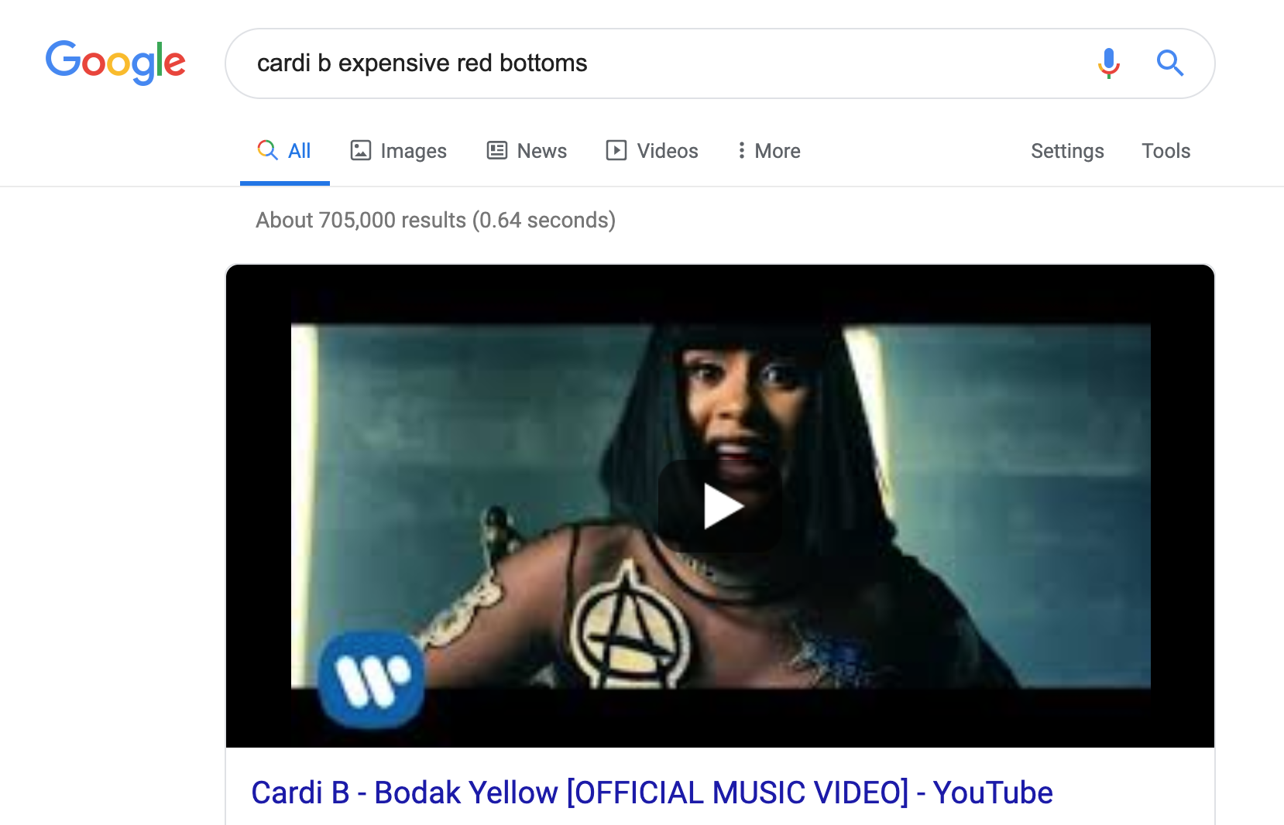
Searching for Information
Booleans, Keywords, Phrases
Keyword Search: a type of search that looks for words anywhere in the record.

Slide 20
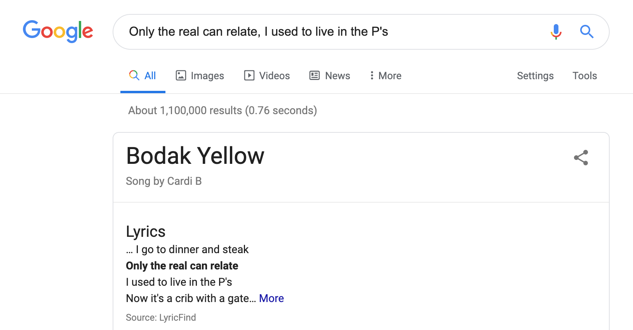
Searching for Information
Booleans, Keywords, Phrases
Phrase Search: a type of search that allows users to search for documents containing an exact sentence or phrase rather than containing a set of keywords in random order.

Slide 21
Searching for Information
Booleans, Keywords, Phrases
Boolean Search: a type of search allowing users to combine keywords with operators (or modifiers) such as AND, NOT and OR to further produce more relevant results.
Keyword Search: a type of search that looks for words anywhere in the record.
Phrase Search: a type of search that allows users to search for documents containing an exact sentence or phrase rather than containing a set of keywords in random order.

Slide 22
Agenda
Introductions
Do Now
Search Engines & Directories
Activity - Job Search
Discussion
Activity - Searching
Discussion - What is Netiquette?
Exit Ticket
Notes:
Cmd+shift+x for strikethrough

Slide 23
Discussion
What Is Netiquette

Slide 24

What Is Netiquette?
Netiquette: Online etiquette is ingrained into culture, although etiquette in technology is a fairly recent concept. The rules of etiquette that apply when communicating over the Internet or social networks or devices are different from those applied when communicating in person or by audio or videophone.

Slide 25

What Is Netiquette?
Social
Business

Slide 26
Exit Ticket

